Slide 1
Parallelization of Clustered Low-Rank Approximation and Its Application to Link Prediction
Xin Sui¹, Tsung-Hsien Lee¹, Joyce Jiyoung Whang¹,
Berkant Savas², Saral Jain¹, Keshav Pingali¹, Inderjit Dhillon¹
¹ The University of Texas at Austin
² Linköping University

Slide 2



Social Network Analysis
Huge size of social network graphs poses great challenge on the analysis
Two important ways to solve the challenge
Parallelization
Large scale distributed parallelization
Approximation
In many cases, approximate answers are sufficient, e.g. friend recommendations
Over 900 million active users
Over 500 million active users
Over 175 million registered users

Slide 3
Need for Approximation
Problem: compute the number of length-k paths between every two vertices in a graph
Solution 1: graph traversals
Too expensive for large graphs
Solution 2: linear algebra formulation
Represent a graph by its adjacency matrix A
A^{K}(i,j) is number of length-k paths between vertices i and j
Still very expensive

Slide 4
Low-rank Approximation
The adjacency matrix of an undirected graph can be approximated by the product of three matrices V, D and V^{T}
r << m, called rank, is an input parameter
The larger the r, the smaller the approximation error
V^{T}V = I (Identity matrix)
A_{mxm}
V_{mxr}
D_{rxr}
V_{mxr}^{T}

Slide 5
Approximating A^{k} by low-rank approximation
A_{mxm}
V_{mxr}
D_{rxr}
V_{mxr}^{T}
2
k
k
A_{mxm}
A_{mxm}
V_{mxr}
V_{mxr}
D_{rxr}
V_{mxr}^{T}
D_{rxr}
V_{mxr}^{T}
V_{mxr}
D_{rxr}
V_{mxr}^{T}
2
V_{mxr}
V_{mxr}^{T}
D_{rxr}
Identity Matrix
Large matrix multiplication becomes small matrix multiplication

Slide 6

The Limitation of Low-rank Approximation
Large rank r is needed for large graphs to make the approximation error acceptable
The computation and memory costs are expensive for large graphs and rank
How to improve it

Slide 7
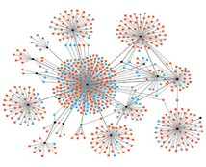
Structure In Social Networks
Not uniformly random graphs
Clusters with few inter-cluster edges
Clustered low-rank approximation
Find clusters by partitioning
Use low-rank approximation for each cluster
Account for inter-cluster edges

Slide 8
Our Contributions
A new parallel partitioning algorithm for social networks
Easy to parallelize
Compared to ParMetis
Faster and scales better
Generates similar quality partitions when ParMetis succeeds
First parallel implementation of clustered low-rank approximation
Application to link prediction of very large graphs

Slide 9
Matrix View of Clustering
n₁
n₁
n₃
n₃
n₄
n₄
n₂
n₂
n₁
n₂
n₃
n₄
n₁
n₃
n₂
n₄
n₁
1
0
1
1
n₁
1
1
0
1
n₂
0
1
0
1
n₃
1
1
0
0
n₃
1
0
1
0
n₂
0
0
1
1
n₄
1
1
0
1
n₄
1
0
1
1

Slide 10
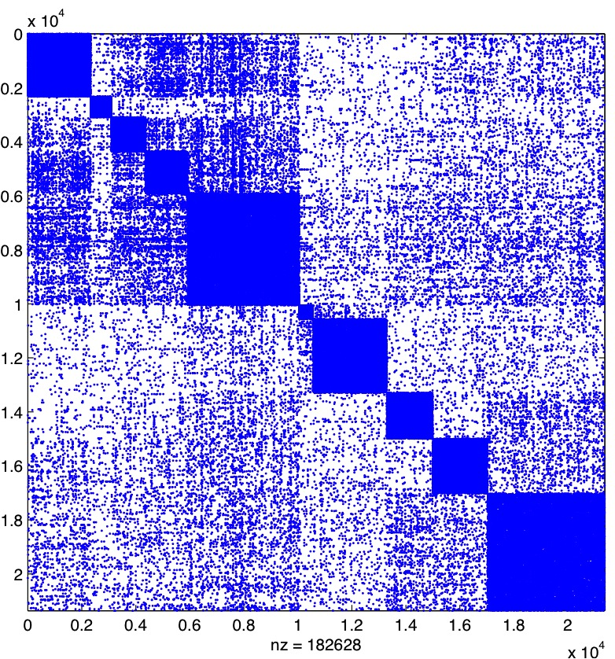
Example: arXiv Network
21,363 vertices and 91,314 edges

Slide 11
Clustered Low-rank Approximation
Step 1
Step 2
Step 3
Graph Partitioning
Low-rank Approximation on diagonal blocks
Approximating Off-Diagonal blocks
V_{i}^{T}
A_{ij}
V_{j}
A_{ii}
V_{i}
D_{ii}
V_{i}^{T}
D_{ij}
A₁₁
A₁₂
A₁₃
A₁₄
v₁
0
_{D11}
_{D12}
_{D13}
_{D14}
v₁^{T}
0
A
v₂^{T}
A₃₁
A₂₂
A₂₃
A₂₄
v₂
_{D21}
_{D22}
_{D23}
_{D24}
v₃^{T}
_{D31}
_{D32}
_{D33}
_{D34}
0
_{D41}
_{D42}
_{D43}
_{D44}
v₄^{T}
A₃₁
A₃₂
A₃₃
A₃₄
v₃
Compared to low-rank approximation
Local structure to speed up computation
Same storage of eigenvectors but higher rank
0
A₄₁
A₄₂
A₄₃
A₄₄
v₄

Slide 12
1. PEK: A new graph partitioning algorithm for social networks
Intuition: High degree vertices capture the high level structure of such graphs
PEK Algorithm:
Extract a small representative sub-graph(high degree vertices and their edges)
Partition this sub-graph
Propagate partitioning to entire graph
Refine with weighted kernel K-Means
Propagate
Partitioning
Refine
Partitioning
Extract subgraph
Project Partitions
Initial Partitioning

Slide 13
Extract a Representative Sub-Graph
Extracts a small number of high-degree vertices and the edges between them
Graph is randomly and evenly distributed across processes
Each process selects its local vertices with degree larger than a threshold
Those vertices and the edges between them form the representative sub-graph

Slide 14
Partition Sub-graph
Use ParMetis to partition sub-graph
Takes a small fraction of time
Project partitions of vertices in sub-graph to original graph
Projected vertices assigned to partitions
Un-projected vertices are not assigned

Slide 15
Propagate Partitioning(1)
Each partition has a virtual center point(centroid)
Initially computed based on the partitions of projected vertices
Distance between a vertex to the centroid of a partition
Measure how close a vertex to the partition
Computed based on the partition size, #edges of the vertex to the partition, #edges within the partitions, etc.

Slide 16
Propagate Partitioning(2)
Visit un-projected vertices in breadth-first order
Start from projected vertices
For each un-projected vertex :
Assign to partition with the closest centroid
Update the centroid
Each process has its own copy of all centroids
Do not synchronize updates of centroids
No impact on partition quality
Centroid of Part₁
Centroid of Part₂

Slide 17
Refine Partitions
Iteratively improve initial partitioning
On every iteration, each process:
Visits its local vertices on the partition boundary
For each boundary vertex v:
Moves v from partition Part_{i} to Part_{j} if v is closer to Part_{j}
If moved, updates the old and new centroids
Processes synchronize updates of centroids once every iteration
Less communication
Does not degrade quality

Slide 18
2. Approximating Diagonal Blocks
Assigns partitions to processes
Each process computes low rank approximation on partitions independently
Sorted by the weights: #nonzero(A_{ii}) x rank
A₂₂
A₃₃
A₁₁
A₄₄
Graph is reorganized after assignment
_{D22}
v₂
A₂₂
A₂₃
A₂₁
A₂₄
P₁
_{D33}
v₃
A₃₂
A₃₃
A₃₁
A₃₄
P₂
P₁
P₂
P₃
_{D11}
v₁
A₁₂
A₁₃
A₁
A₁₄
P₃
Assigns partition to the process currently
having the least weights
_{D44}
v₄
A₄₂
A₄₃
A₄₁
A₄₄

Slide 19
3. Approximating Off-Diagonal Blocks
Undirected graph => symmetric adjacency matrix A
Only one of A_{ij} and A_{ji} needs to be approximated
A job, J_{i, j} , _{i<j} , denotes approximating either A_{ij} or A_{ji}
Private jobs of process P_{i,} e.g. J_{1,4}
Can be finished by P_{i} without communication
Shared jobs between Pi and Pj, e.g. J_{2,3}
Either P_{i} or P_{j} can finish it
Communication is needed between P_{i} and P_{j}
Processes first finish its private jobs
Dynamic load balancing for scheduling shared jobs
_{D22}
v₂
A₂₂
A₂₃
A₂₁
A₂₄
P₁
_{D33}
v₃
A₃₂
A₃₃
A₃₁
A₃₄
P₂
_{D11}
v₁
A₁₂
A₁₃
A₁
A₁₄
P₃
_{D44}
v₄
A₄₂
A₄₃
A₄₁
A₄₄

Slide 20
Experimental Setting
Machine: Ranger(Texas Advanced Computing Center)
Each node has a 4 x 4-core AMD Opteron 2.2GHz CPU and 32GB memory.
InfiniBand networks with 5GB/s point-to-point bandwidth
Libraries: Intel ICC 10.1, OpenMPI 1.3, ARPACK++, GotoBLAS 1.3 and Elemental 1.7
Assign one process per node

Slide 21
Datasets
Converted the graphs to undirected graphs, the table shows the statistics of graphs after conversion
Name | #Vertices | #Edges | Description
SocLive | 3,828,682 | 39,870,459 | LiveJournal online social network
Twitter_10M | 11,316,799 | 63,555,738 | Twitter social network
Twitter_40M | 41,652,230 | 1,202,513,046 | Twitter social network

Slide 22
Runtime and Speedup of Parallel Clustered Low-rank Approximation
#Partitions
SocLive: 500
Twitter_10M: 500
Twitter_40M: 1000
Rank for Diagonal Phase
SocLive: 100
Twitter_10M: 100
Twitter_40M: 100

Slide 23
Runtime and Speedup in Each Phase
Partitioning and offDiagonal phases scale well
Diagonal phase does not scale well for small graphs
Runtime in Each Phase
Speedup

Slide 24
Load Balancing of diagonal and offDiagonal Phases
#Partitions are small compared to #Processes, not enough space for load balancing in diagonal phase
#Partitions:
SocLive: 500
Twitter_10M: 500
Twitter_40M: 1000

Slide 25
Graph Partitioning Comparing PEK with ParMetis
#Partitions: 500
Degree Threshold:
SocLive: 42(5% vertices)
Twitter_10M:200(less than 5% vertices)
Cut-size and NormCut
Lower is Better
cut-size: the edges across partitions
NormCut: normalized cut-size by the total degree of vertices of each partition
divided by the number of clusters
ParMetis cannot partition Twitter_40M since the memory is not enough

Slide 26
Link Prediction
Our parallel clustered low-rank approximation enabled first ever study of Katz measure on large real-world social networks
Randomly remove 30% edges from graphs and perform link prediction on the resulting graphs.
Precision is the ratio of correct predictions in top-k predictions
#partitions:500
rank of diagonal:50
#partitions:500
Rank of diagonal:100

Slide 27
Conclusion
Developed a new graph partitioning algorithm for social networks
Fast and scales well to large number of processes
Faster than ParMetis and similar partition quality as ParMetis
Parallelized clustered low-rank approximation and applied it on large real-world social networks
Benchmark combines:
Irregular and regular computations
Dense and sparse data structures
Approximation and Parallelization are the keys for solving large scale social network problems

Slide 28

Thank You!

